Slide 1
SUPER MARKET BILLING SYSTEM
By Vydeti Sruthi Sree

Slide 2
ABSTRACT
The Supermarket Billing System is a Java-based application designed to simplify billing and inventory management in a retail store. It allows customers to view available products, add items to a cart, and generate a detailed bill with automatic calculation of prices and taxes. The system uses exception handling to manage errors such as out-of-stock items or invalid product selections, ensuring smooth and reliable operations. Additionally, the functionality is verified through basic test cases that check out-of-stock conditions, and accurate billing. By automating billing and inventory updates, it reduces errors, saves time, and provides an organized and efficient solution for both shopkeepers and customers.

Slide 3
TECH STACK
Language: Java-used for implementing Object-Oriented concepts like classes, exceptions, and collections.
Database: MySQL-to store and manage product and inventory data efficiently.
Persistence: JDBC-to establish and handle database connectivity and CRUD operations.
Build Tool: Maven-for project dependency management and modular organization.
Testing: Junit-used for unit testing and ensuring code reliability.

Slide 4
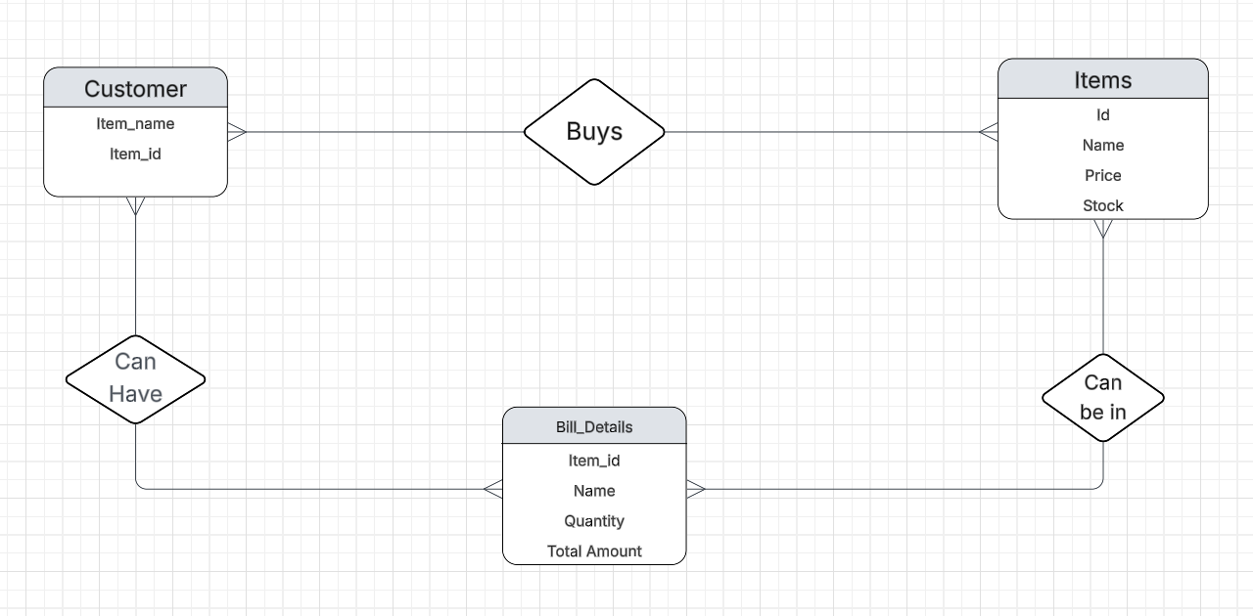
ER Diagram

Slide 5
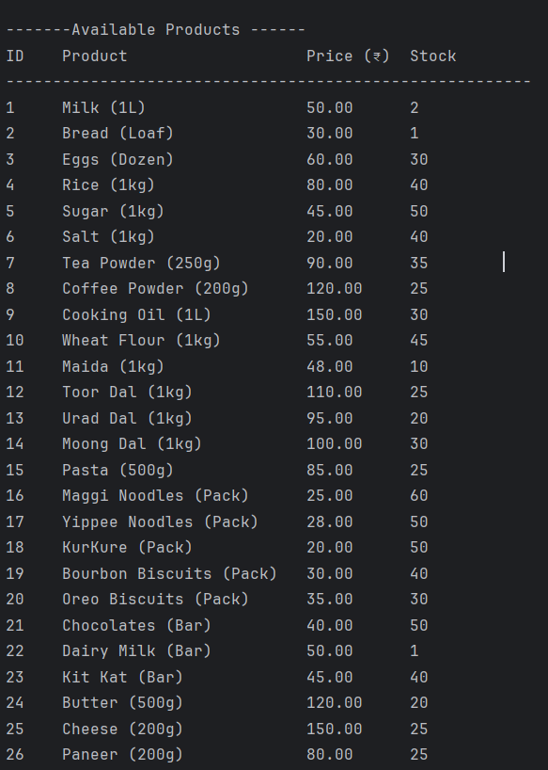
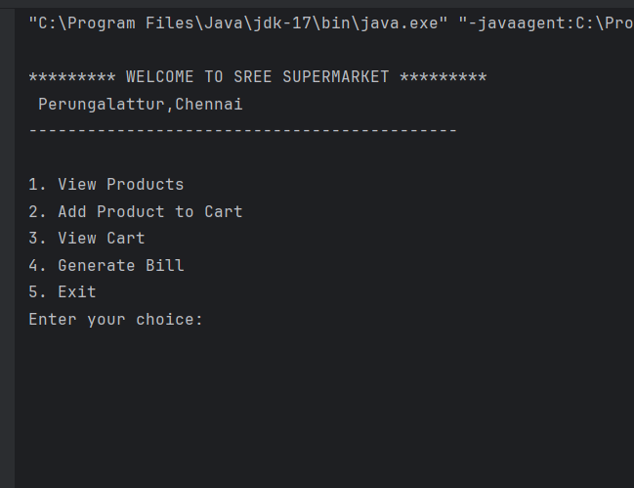
OUTPUT
Fig.1 Super Market Billing Console
Fig.2 Available Products

Slide 6
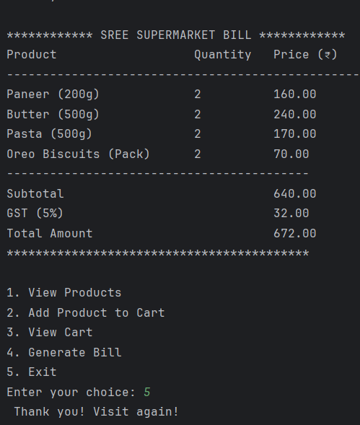
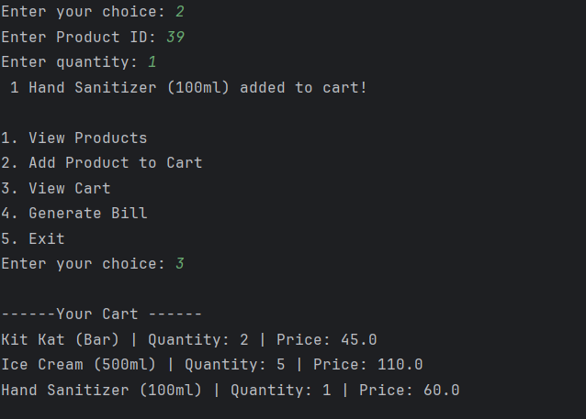
Fig.3 Items in Cart
Fig.4 Bill Generation

Slide 7
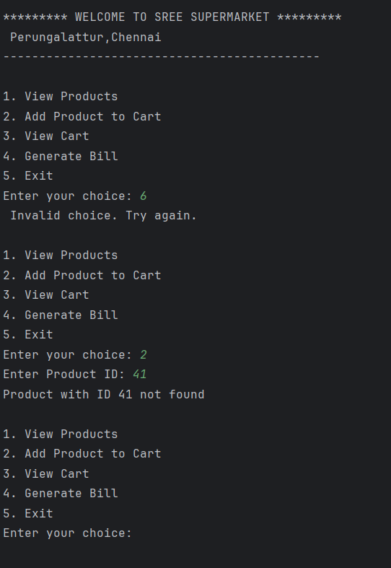
Fig.5 Exception Handling

Slide 8
CONCLUSION
This is a console-based Supermarket Billing System that automates billing and manages inventory.
It uses concepts like OOP, DAO pattern, exception handling, and database integration for clean and reliable functionality.
Future enhancements can include storing customer-wise bills with dates and creating a web-based GUI version for better usability.

Slide 9
THANK YOU

